Slide 1
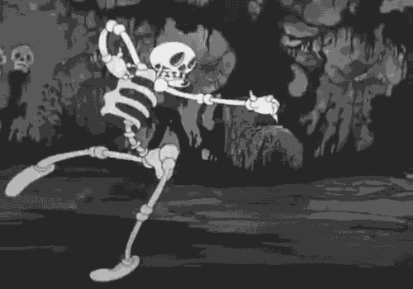
Spooky Author Identification (Text Classification)
By
Chirag Padsala | 805613197
Hirva Shah | 805654761
Nikita Tank | 805703204
Nishant Rathi | 805602687
Shantanu Mishra | 893361006

Slide 2
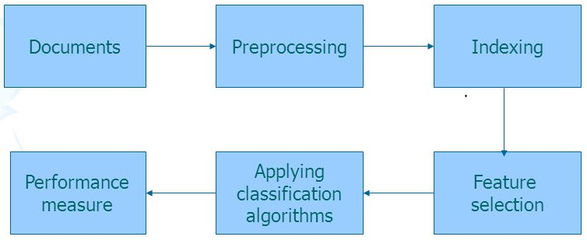
Outline
Project definition
Description of Dataset
Data Processing
Algorithms
Kaggle Submission
Project results
Challenges and Achievements
Conclusion
References

Slide 3
Problem Statement
The Dataset contains texts from books of fiction written by authors of the public domain: Edgar Allan Poe(EAP), HP Lovecraft(HPL) and Mary Wollstonecraft Shelley(MWS).
The data was prepared by chunking larger texts into sentences using CoreNLP's MaxEnt sentence tokenizer.
Dataset contains 2 files. train.csv-training set, test.csv-the test set
Features:
Id - unique identifier for each sentence, Text - statements written by one of the three authors Author - the author of the sentence are the data fields of the dataset.

Slide 4
Dataset Description

Slide 5
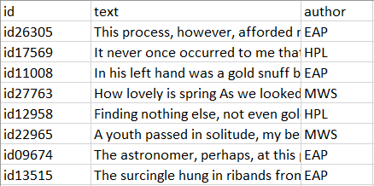
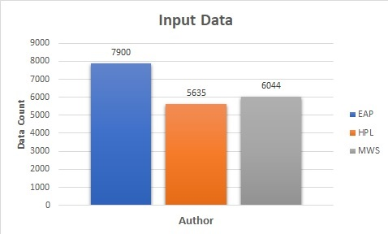
Training Data
Total training data - 19580

Slide 6
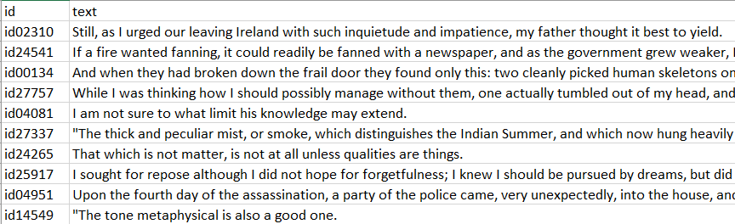
Testing Data
Total records 8393
Predict Probabilities for Author

Slide 7
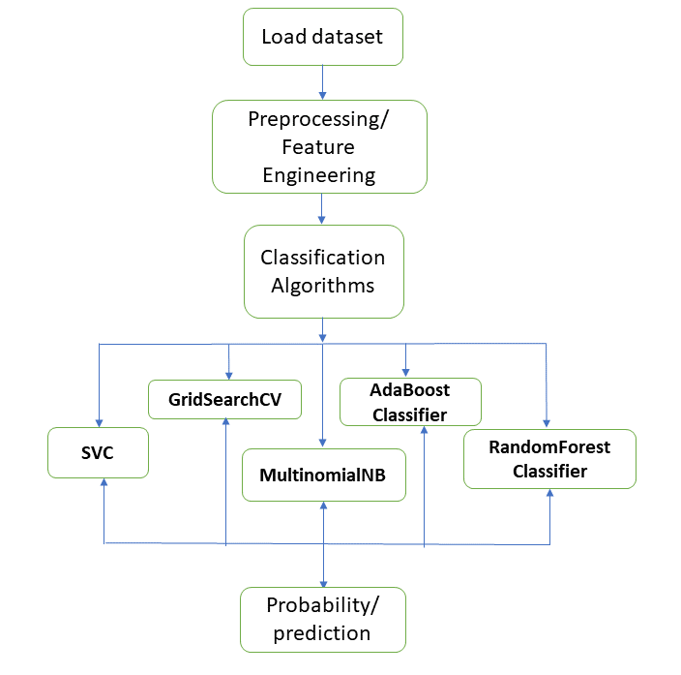
Flowchart

Slide 8
Data Processing
Stemming
Inverse Document Frequency
Tf_Idf = TF*Idf (Vocabulary)
Transformed Sparse Matrix
Term Frequency
Labelling
Converting Text to Numeric form
Different Branches all converted to single word stem .(Jumped,jumping-> Jump,)
TF(t) = (Number of times term t appears in a document) / (Total number of terms in the document)
IDF(t) = log_e(Total number of documents / Number of documents with term t in it).
Word with tfidf score for each word in the text data
Matrix with tfidf score for the text data

Slide 9
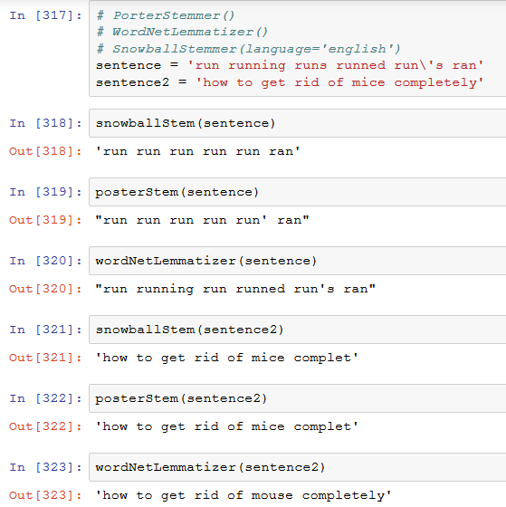
Stemming and Lemmatization
Stemming
Poster Stemmer
Snowball Stemmer
Lemmatization
- WordNetLemmatizer

Slide 10
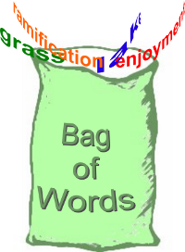
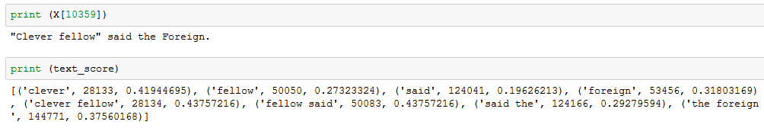
TF-IDF
Term Frequency
Word count for each document
Inverse Document Frequency
Word count by number of documents

Slide 11
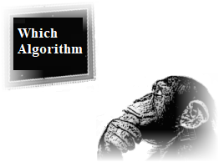

Algorithms
XgBoost | AdaBoost | Random Forest | SVC | MultinomialNB

Slide 12
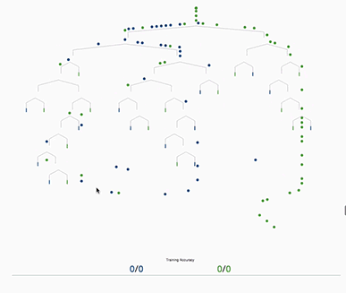
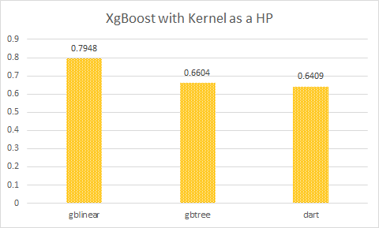
eXtreme Gradient Boosting
Additive tree model: add new trees that complement the already-built ones.
Response is the optimal linear combination of all decision trees.
Popular in Kaggle competitions for efficiency, portability and flexibility.

Slide 13
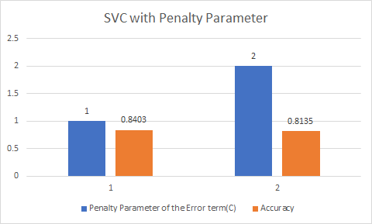
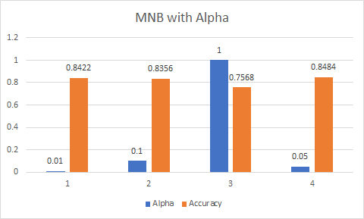
Hyper-Parameters

Slide 14
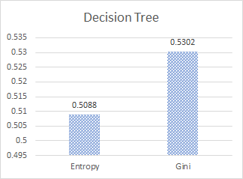
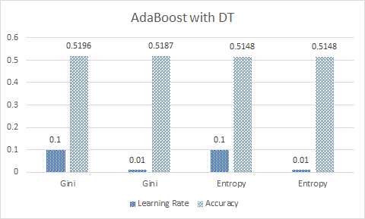
Adaboost
Fit an additive model in a forward stage-wise manner.
In each stage, introduce a weak learner to compensate the shortcomings of existing weak learners.
In Adaboost,“shortcomings” are identified by high-weight data points.

Slide 15
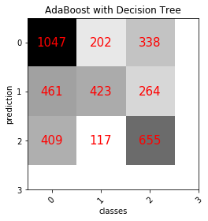
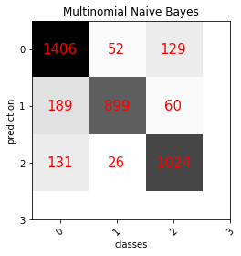
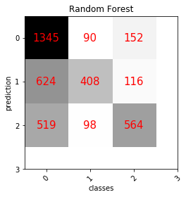
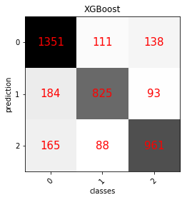
Confusion Matrix
Notes:
XG img is in drive

Slide 16
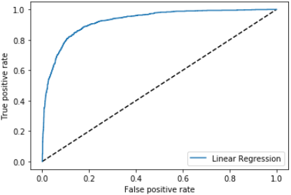
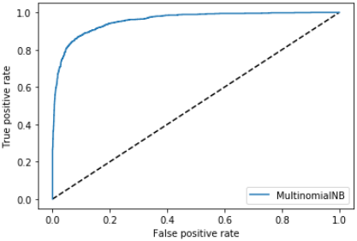
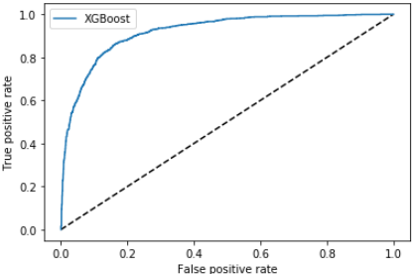
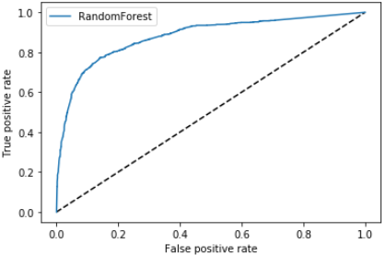
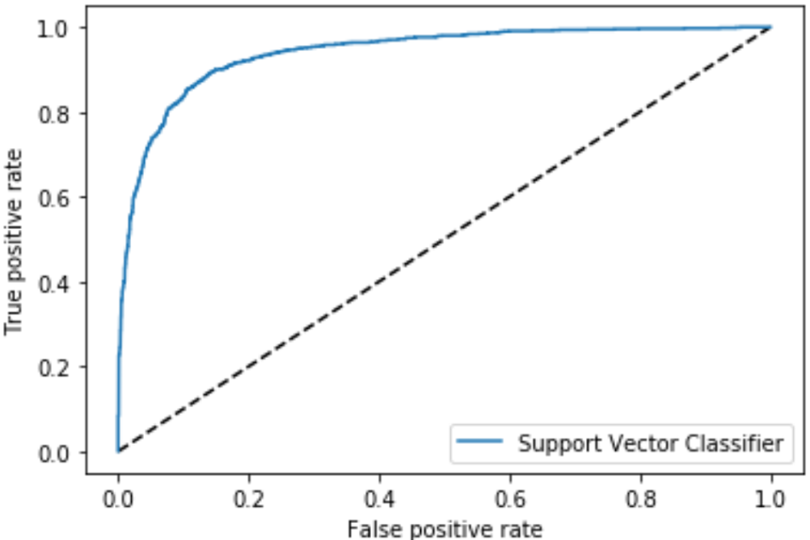
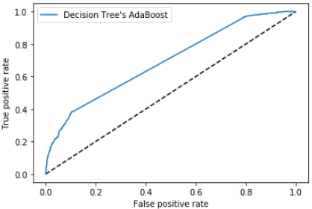
ROC

Slide 17
Comparison of Worst and Best Submission
Worst Submission | Best Submission

Slide 18
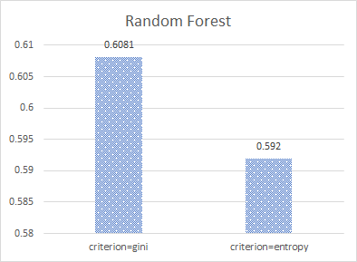
Random Forest
n_estimators | 10 | 100 | 1000
Output | [ 0.2 0.4 0.4] [ 0.3 0.2 0.5] | [ 0.15 0.65 0.2 ] [ 0.42 0.26 0.32] | [ 0.232 0.503 0.265] [ 0.389 0.284 0.327]
Notes:
10 ka output is with rathi
10: array([[ 0.5, 0.3, 0.2], [ 0.5, 0. , 0.5], [ 0.7, 0. , 0.3], ..., [ 0.1, 0.2, 0.7], [ 0.5, 0.1, 0.4], [ 0.4, 0.2, 0.4]])
100: [[ 0.31 0.12 0.57] [ 0.49 0.39 0.12] [ 0.18 0.62 0.2 ] ..., [ 0.69 0.18 0.13] [ 0.44 0.17 0.39] [ 0.48 0.46 0.06]]
1000: [[ 0.28 0.113 0.607] [ 0.601 0.278 0.121] [ 0.188 0.667 0.145] ..., [ 0.751 0.141 0.108] [ 0.427 0.172 0.401] [ 0.435 0.471 0.094]]

Slide 19
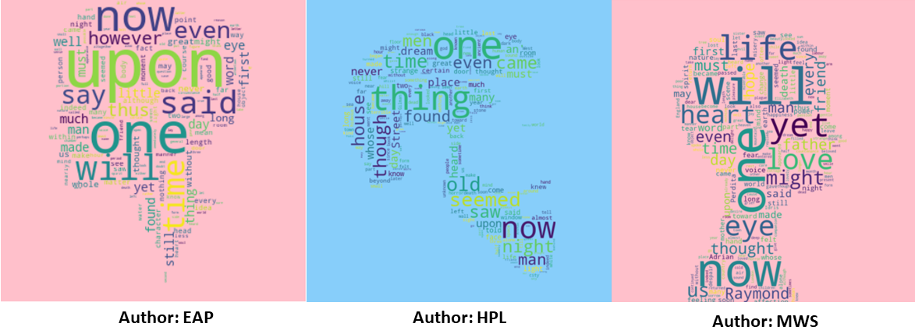
Word Cloud Image (Train Dataset)

Slide 20
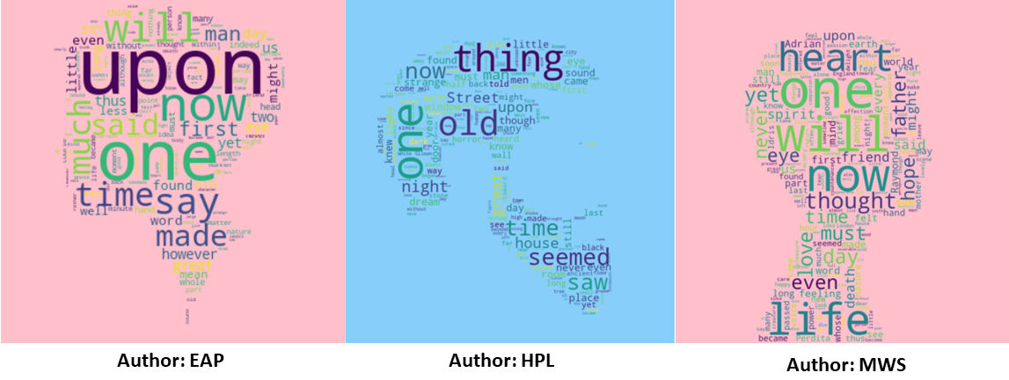
Word Cloud Image (Test Dataset)
Notes:
Is possible for change the back ground color of 1st image
Yes Which color do u want ??
https://www.w3schools.com/colors/colors_names.asp
Pick one and let me know
I want to prepare for finals and report…
Please let me know early
Any color except green
Our words are in green color so i cant see them properly
Make it like last image that one is perfect i can everything
Leave it
I can make it
So same color for first and last image right !!!
Dont do anything
Looks good i checked your previous slide you can compare them

Slide 21
Kaggle Submission
Submission | 1 | 2 | 3 | 4 | 5 | 6
Algorithm | Random Forest | Multinomial NB | Multinomial NB | SVC | Multinomial NB (Lemmatizer) | Multinomial NB (Stemmer)
Stopwords | No | Yes | No | No | No | No
Parameters | n_jobs=-1 n_estimators=1000 | alpha=0.08 | alpha=0.1 | Snowball Stemmer, kernel=linear, C=1, probability=true | Word Net Lemmatizer, alpha = 0.05 | Snowball Stemmer, alpha = 0.05
Accuracy | 0.66 | 0.82 | 0.84 | 0.80 | 0.83 | 0.84
Kaggle Score | 0.76 | 0.51 | 0.50 | 0.41 | 0.36 | 0.35

Slide 22
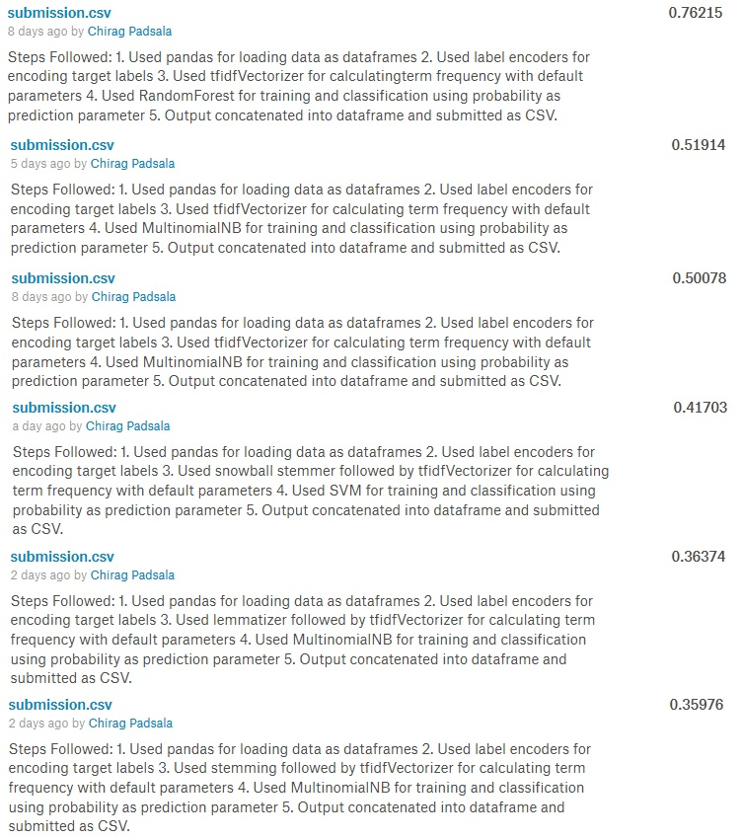

Slide 23
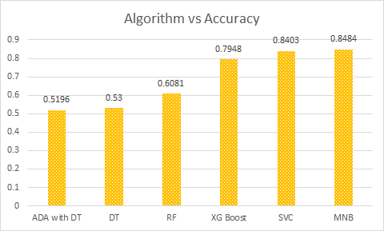
Algorithm Comparison

Slide 24
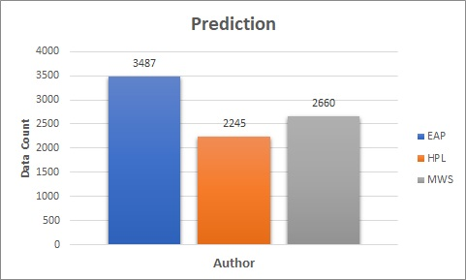
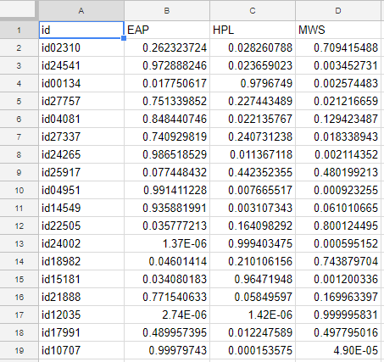
Results

Slide 25
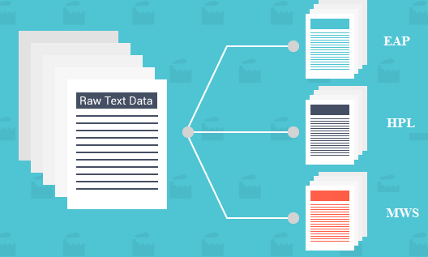
Challenges
Dataset
Pre-processing / Feature Engineering of data
Parameter Selection
Stopwords issue (Manually added more stopwords)
Setup and Installation
Version / Dependency issues with python for xgBoost

Slide 26


Achievements
Understood the importance of different parameters
Learning Rate(alpha)
Validation percentage
Stop Words
Bag of words
Preprocessing of training data improved the prediction.
Used boosting method to improve the performance.

Slide 27
Conclusion
Finding the best combination of features and parameters for text classification.
Importance of Data Preprocesssing.
Boosting algorithm improves execution speed and performance of existing model(algorithm).
Multinomial Naive Bayes gives better prediction result on text data.

Slide 28
References
https://www.kaggle.com/c/spooky_author_identification
https://www.kaggle.com/arthurtok/spooky-nlp-and-topic-modelling-tutorial
https://anaconda.org/
http://scikit-learn.org
https://www.lfd.uci.edu/~gohlke/pythonlibs/

Slide 29


Slide 30



